Slide 1
Emotion Analysis of Twitter using Opinion Mining
Akshi Kumar Delhi Technological University | Prakhar Dogra Delhi Technological University | Vikrant Dabas Delhi Technological University

Slide 2
Our Goal
The goal of our research was to do emotion analysis on tweets using opinion mining.
The main idea of the research was to create a model that is able to predict the type of emotion of a tweet using web mining to initially extract tweets using the Twitter API and then further using sentiment analysis to analyze the emotions.
The model is made using two modules that are named as follows:
Data cleaning module
Scoring (emotion value) module

Slide 3
Why select a microblogging website like Twitter?
It is used by people of different domains to express their emotions, views and opinions.
It contains sheer amount of text posts that grows at large rate everyday.
It is used by people from many countries.
It involves variety of people from ordinary users to celebrities of various fields like entertainment, sports, politics, education, etc.

Slide 4
Background work
Kumar and Sebastian [1] introduced a hybrid approach which combines the advantages of both dictionary & corpus based methods along with the combination of NLP & ML based techniques to classify tweets into positive, negative, neutral categories.
EmpaTweet [2] describes an emotion corpus that is created from the micro-blogging service Twitter. The corpus contains 7 different emotions (Anger, Disgust, Fear, Joy, Love, Sadness and Happiness) annotated across 14 topics.

Slide 5
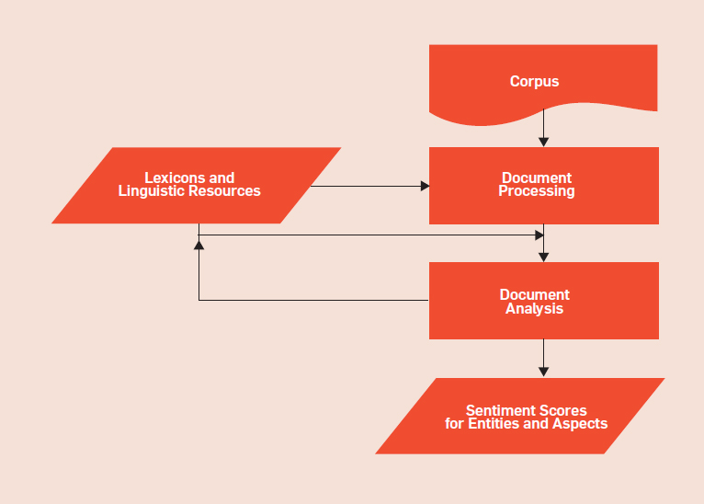
Generic Sentiment Analysis Model

Slide 6
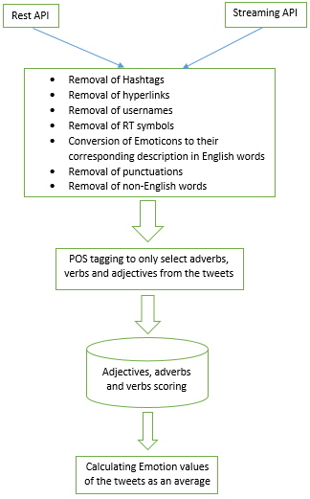
System Architecture
We now present the architecture of the system proposed for our emotion analysis. It mainly involves:
Tweet retrieval Module
Preprocessing (cleaning) Module
POS Tagging
Emotion Scoring Module

Slide 7
Retrieving Tweets

Slide 8
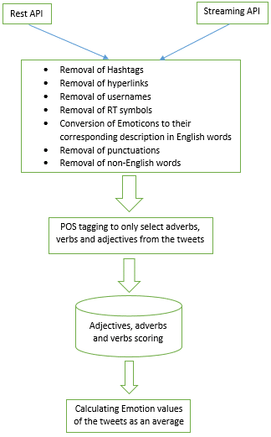

Slide 9
Data Cleaning Process

Slide 11
Data Cleaning Process
The following strategy has been followed to clean the downloaded twitter data:-
For Removal of #tags, a substring removal python function is used.
Similar to the removal of hashtags, substring removal function is used to remove the links in the tweets.
Emoticon processor: Emoticons are heavily used in tweets but since they are non-english words so they are removed in the cleaning module. So they need to be identified before that.
Each punctuation is replaced by an empty substring
Removal of strings generally present in tweets such as RT, @someUser etc. through the substring removal function.

Slide 12
Proposed Scoring Module

Slide 14
Proposed Scoring Module
We have proposed several scoring methods/formulas to calculate the average emotion value of tweets of a handle(username) or hashtag:
Emotion value = sum of adjective values + sum of adverb and verb values
(no. of adjectives * 5) + no. of adverb and verb
2. Multiply the value of adverb/verb with the upcoming adjective . If two verb /adverb are next to each other, simply multiply them. And then all these products are added. Further divided by 5*number of adjectives encountered.
3. If the value of adverb/verb is less than 0 i.e, negative , then for the upcoming adjective, subtract its value from 5 instead of multiplying . And if value of verb/adverb is positive and >= 0.5 then multiply it with the upcoming adjective else multiply 0.5 with upcoming adjective. Later these products are added and the sum is divided by 5*number of adjectives encountered.
4. Since the emotions are independent of each other, we should treat them independently and use a different formula for each emotion. We have used normalising values of different emotions. These predefined values are used to normalize the emotion values. In this method an assumption is taken that if an emotion is strong it’s respective value is > 3 (out of a scale of 5).

Slide 15
Scoring Module
This algorithm is based on the idea that whenever there is an adverb/verb in front of an adjective there is bound to be an effect on the emotion expressed by the same adjective. It can be either negative or negative. Keeping this in mind we have created method to calculate the emotion values.
If the value of adverb/verb is less than 0 i.e, negative , then for the upcoming adjective, subtract its value from 5 instead of multiplying . And if value of verb/adverb is positive and >= 0.5 then multiply it with the upcoming adjective else multiply 0.5 with upcoming adjective. Later these products are added and the sum is divided by 5*number of adjectives encountered.
And if there are more than 1 adverbs/verbs before an adjective then they are multiplied together.

Slide 16
Example:
For example we have a tweet: “She is not very beautiful”
This tweet is first converted to “not very beautiful” using the POS Tagger.
In this string, words are processed one by one.
In this example we see that the first word (“not”) encountered is an adverb. The score is assigned to the sum value. (sum = -0.8)
Then second word is encountered. We see that it (“very”) is also an adverb.
The new sum is an addition of the scores from the previous word and the present word. In this case the sum value is (sum = -0.8 + 0.4 = -0.4)
Third word encountered is an adjective. So the sum produced is multiplied with the emotion scores of that adjective. If there are no adverbs or verbs before the adjective then no such sum is multiplied.
In this case, the scores produced are ([<Happiness>, <Anger>, <Sadness>, <Fear>, <Disgust>] = [0.098, 0.756, 0.736, 0.738, 0.764].
In case of more than one adjective-adverb/verb set, the scores of these sets are averaged.

Slide 17
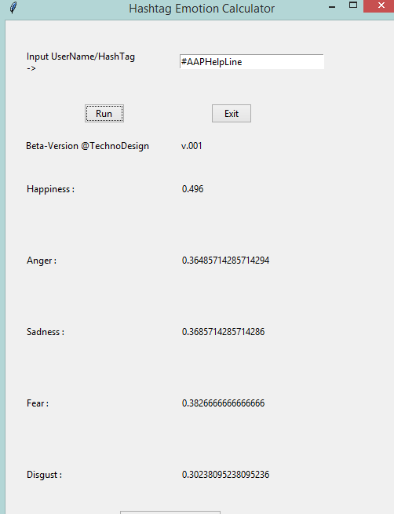
Emotion Values when 1000 tweets are downloaded from #AAPHelpLine

Slide 18
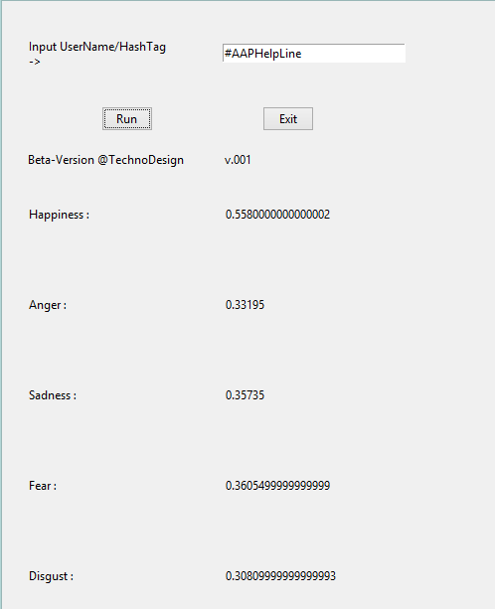
Emotion Values when 1000 tweets are downloaded from #AAPHelpLine

Slide 19
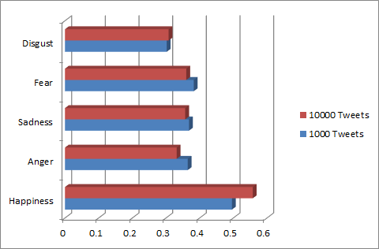
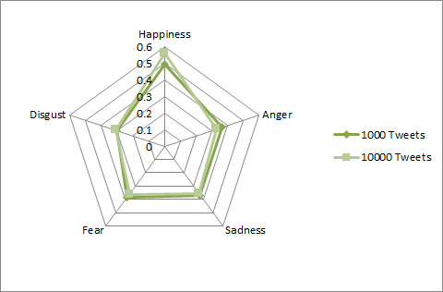
Bar Graph and spider chart of emotion values

Slide 20
Work Yet to be Done
Following is the list of functionalities/modules that haven’t been added in the model:
Sarcasm Detection module: Many a times, people convey emotions through sarcasm. It has become popular and most of the times, the tweet that has been re-tweeted maximum number of times is a play on sarcasm only.
Spell Correction module: This module is required to convert the shorthand notations that usually used in tweets into proper words so as to make them visible to POS_tag function. This module has to be implemented before the usage of POS_tagging.
Apriori Association: We haven’t used any association rule between adverb/verb-adjective pair (or triplet). This method will provide a method that shows how much the adverb/verb affects the following adjective.
Dictionary Expansion Module: It is used for creation and further expansion of an independent dictionary that stores the emotion values of adjectives, adverbs and verbs that are not present in the original dictionary.

Slide 21
Contact Information
For further inquiries or discussion regarding our research you can contact on our emails:
Dr.Akshi Kumar : akshi.kumar@gmail.com
Prakhar Dogra : prakhardogra@gmail.com
Vikrant Dabas : vikrantdabas@hotmail.com

Slide 22
Thank You

